Slide 1
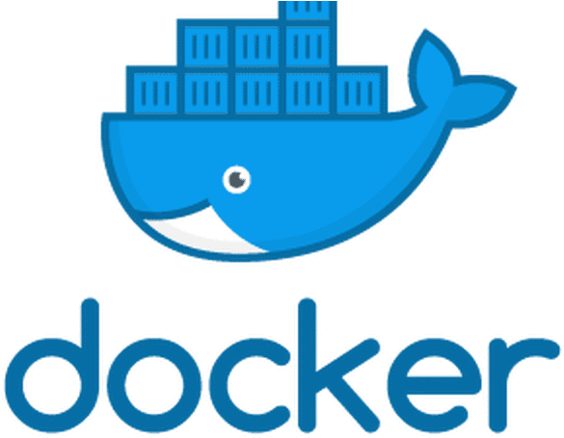
Docker 101

Slide 2
What is Docker?
Docker is a containerization technology that enables lightweight application segmentation, portability and isolation
Functionally similar to, but much lighter weight than, traditional Virtual Machines (VMs)
Four to six times more containerized applications can be run on a given server machine than the if the applications were to be run in separate VMs (when done properly)
Docker lends itself to Continuous Integration/Continuous Deployment (CI/CD) build, test and deployment environments
Used heavily in cloud-scale application development

Slide 3
How does Docker differ from traditional VMs?
VMs use hardware virtualization and hypervisors, and can run different operating systems and kernels on separate VMs on the same hardware
Docker uses OS virtualization, the host kernel is shared among all containers
VMs running on the same host may be more secure than containers, but when developing or running trusted containers, this is often not a primary concern
Containers boot much faster than VMs (milliseconds vs. seconds), which makes scaling applications up and down much simpler

Slide 4
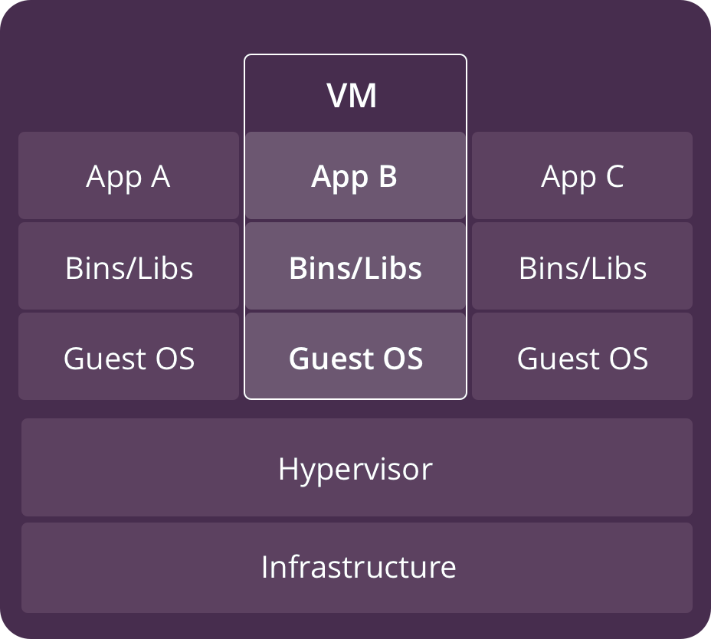
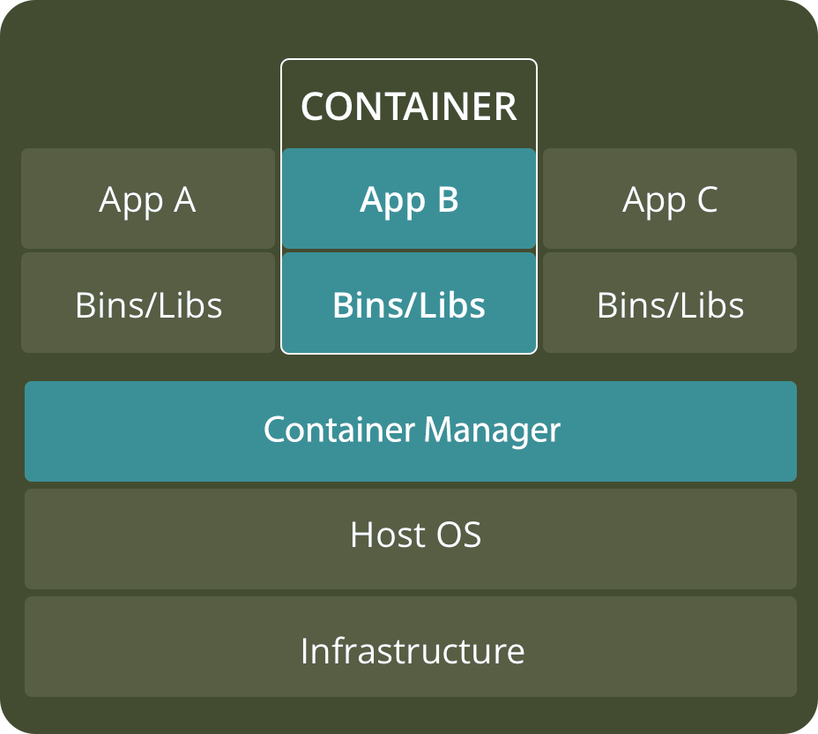
VMs vs. Containers

Slide 5
Benefits of Containers
Reduced IT management resources
Reduced size of snapshots vs. VM images
Quicker spinning up apps – milliseconds to a few seconds vs. many seconds to minutes
Reduced & simplified security updates
Less code to transfer, migrate, upload workloads
Isolated application environment
Complex environments are easily shared, when built properly e.g. without external dependencies. Solves the ‘works on my machine’ problem
Greatly improved repeatability for application build and deploy

Slide 6
What Docker can help with at SSCI
Containerizing complex build environments can eliminate the dependency on a single, hard to maintain build machine
Containers can make it easy to have multiple, different test environments that can be layered on top of a common substrate
Docker container layers can help abstract common environments, allowing developers to focus on any additional configuration or tooling needed to, for example, build multiple versions of a system as requirements change over time.

Slide 7
Getting started with Docker
https://phoenixnap.com/kb/how-to-install-docker-on-ubuntu-18-04
docker run hello-world
docker pull python
docker image ls
docker ps [-a]
docker history python:latest
docker system prune -a

Slide 8
Example Python application (Python 3.6+)
import platform
print(f'Hi from Python {platform.python_version()}')

Slide 9
Example Dockerfile
FROM python:latest
COPY hi.py .
CMD python hi.py

Slide 10
Building and running a Docker image
docker build . --tag hi:latest
docker run hi

Slide 11
Peeking inside the container
docker run -it hi /bin/sh
ls
whoami
python --version

Slide 12
Mounting host paths into a container

Slide 13
Use cases

Slide 14
Orchestrating several containers

Slide 15
Reference and Further Reading
https://docs.docker.com/samples/
https://docs.docker.com/develop/develop-images/dockerfile_best-practices/
https://cloud.google.com/blog/products/gcp/7-best-practices-for-building-containers

Slide 16
Useful docker commands
Save a container to a .tar or .tar.gz:
docker save myimage:latest > myimage_latest.tar
docker save myimage:latest | gzip > myimage_latest.tar.gz

